Slide 1
Lecture 1
Introduction to Blueprints

Slide 2
Lecture Goals and Outcomes
The goals of this lecture are to
Introduce Blueprints
Explain the Blueprint Editor interface
Demonstrate how to create Blueprint classes
Introduce the concept of parent-child inheritance
Show how to place nodes in the Event Graph
Explain the Blueprint graph execution
By the end of this lecture you will be able to
Create Blueprint classes in the Editor
Differentiate between Level Blueprints and Blueprint classes
Place nodes in the Event Graph
Understand the basic concept of parent-child inheritance
Understand the execution flow of a Blueprint

Slide 3
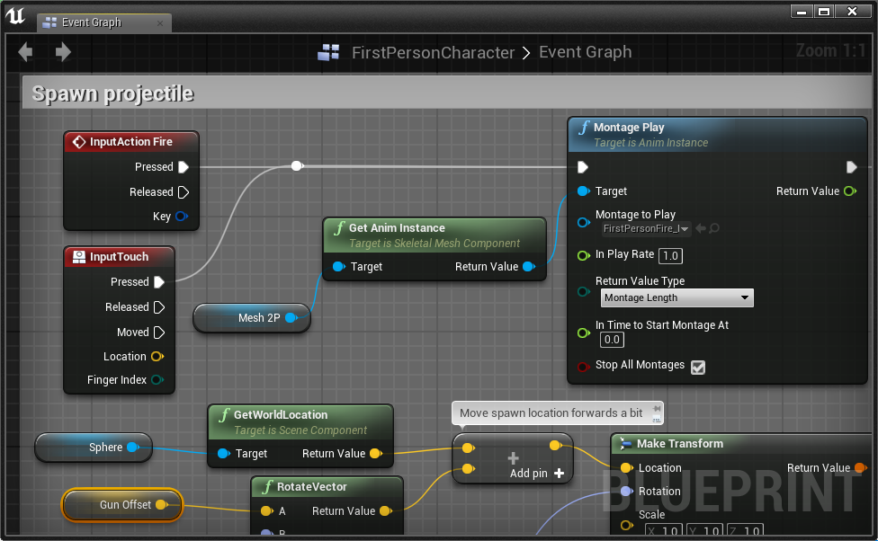
What is Blueprint?
Blueprint is a visual scripting language created by Epic Games for Unreal Engine 4. It is used within the Unreal Editor to create new classes and gameplay functionality.
A script in Blueprint is represented by graphs of nodes connected by wires that define the flow of execution.
The word “Blueprint” is also used to refer to a game object created using Blueprint.

Slide 4

MAJOR BLUEPRINT TYPES
Level Blueprint
Blueprint Class
A Level Blueprint is a special type of Blueprint that belongs to a Level. It is used to define specific events and actions in a Level.
A Level Blueprint can be used to interact with Blueprint Actor classes and to manage some systems, such as cinematics and Level streaming.
A class is the definition of data and behavior that will be used by a particular type of object. A Blueprint class can be based on a C++ class or on another Blueprint class.
A Blueprint class is used to create interactive objects for the game and can be reused in any Level.

Slide 5
Object, Actor, and actor Component Classes
When creating a new Blueprint class, you must define the parent class. All variables and actions of the parent class will be part of the new class, which is known as a child class or subclass. This concept is called inheritance.
Below are some parent classes:
Object: The base class for objects in Unreal Engine. All other classes are subclasses of the Object class.
Actor: The base class used for objects that can be placed or spawned into a Level.
Actor Component: The base class for components that define reusable behavior that can be added to Actors.
Therefore, every Actor is an Object, but not all Objects are Actors. For example, an Actor Component is an Object, but it is not an Actor.

Slide 6
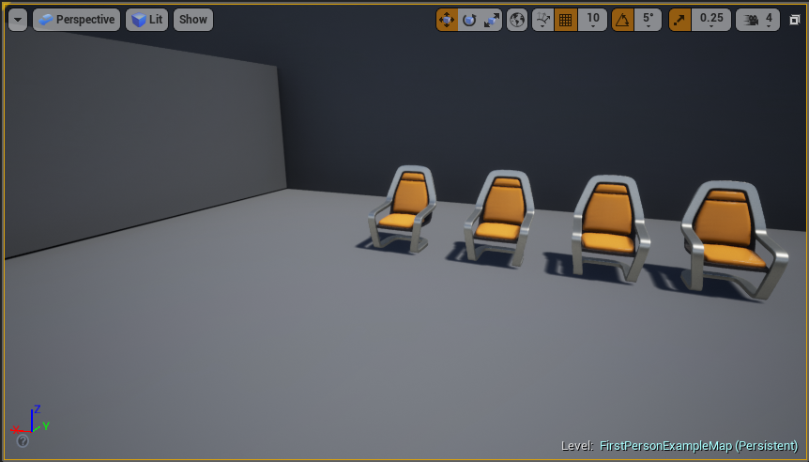
Instances of a class
“Instance” is a term used to reference an object of a class.
An example can be seen in the image on the right. Assuming there is a class called “Blueprint_Chair” that represents a chair, the image shows that four instances of the Blueprint_Chair class have been added to the Level.

Slide 7
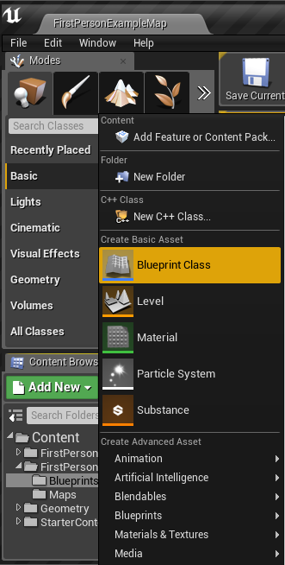
Creating Blueprint classes: the Content Browser
To create a new Blueprint class in the Content Browser, click the green Add New button and select “Blueprint Class”.

Slide 8
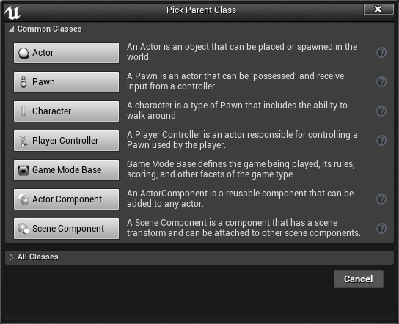
Creating Blueprint classes: Pick parent class window
The next step is to choose the parent class of the new Blueprint.
The image on the right shows the most commonly used classes listed in the Pick Parent Class window. Other parent classes can be found by expanding the All Classes option.

Slide 9
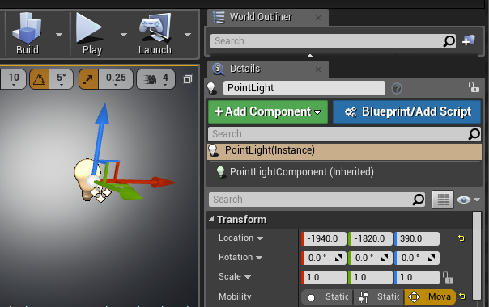
Creating Blueprint classes: Actors in the Level
It is possible to create Blueprint classes based on Actors that have been placed in the Level.
To do this, select the Actor in the Level and click the blue Blueprint/Add Script button in the Level Editor’s Details panel.
The class of the Actor will be used as the parent class of the new Blueprint.

Slide 10
Blueprint editor interface

Slide 11
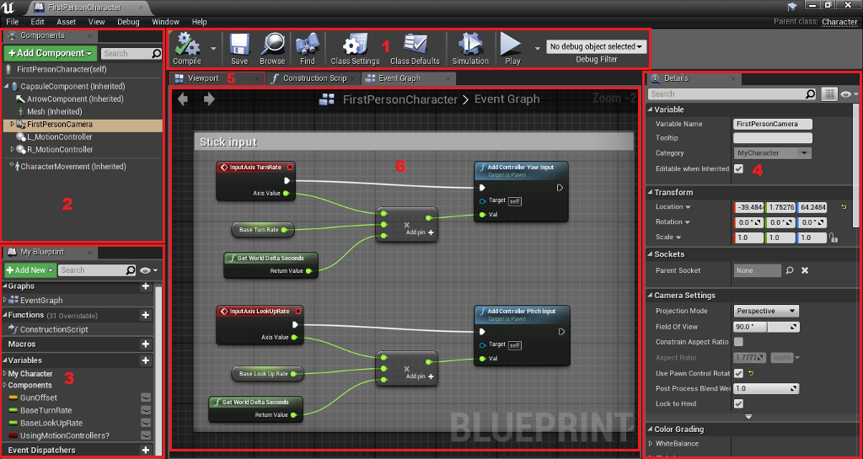
Blueprint editor: overview
To open the Blueprint Editor, double-click on a Blueprint or right-click and choose “Edit...”.
The main parts of the Blueprint Editor, highlighted in the image to the right, are as follows:
Toolbar
Components panel
My Blueprint panel
Details panel
Viewport
Event Graph

Slide 12
Blueprint editor: toolbar
The Toolbar, located at the top of the Editor, has a few essential buttons for editing Blueprints:
Compile: “Compiles” the Blueprint, necessary for validating the code and applying modifications.
Save: Saves all changes made to the current Blueprint to disk.
Browse: Shows the current Blueprint class in the Content Browser.
Find: Searches nodes within a Blueprint.
Class Settings: Opens Blueprint properties.
Class Defaults: Allows for modification of the initial values of the Blueprint variables.

Slide 13
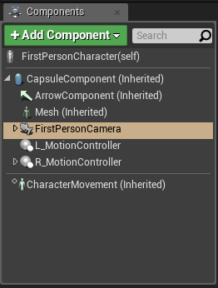
Blueprint editor: Components panel
In the Components panel, various types of components can be added to the current Blueprint.
Examples of components are Static Meshes, lights, sounds, and geometric volumes used in collision tests.

Slide 14
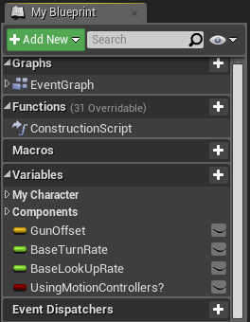
Blueprint editor: My Blueprint panel
The My Blueprint panel is used to manage the variables, macros, functions, and graphs of the Blueprint.
It is separated into categories, and each category has a “+” button for adding new elements.

Slide 15
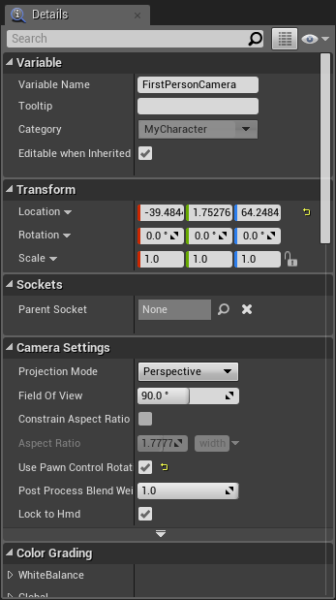
Blueprint editor: details panel
The Details panel shows the properties of the currently selected element of the Blueprint class, which can be a variable, function, or component.
These properties are organized into categories, and their values can be modified.
At the top of the panel, there is a search box that can be used to filter the properties.

Slide 16
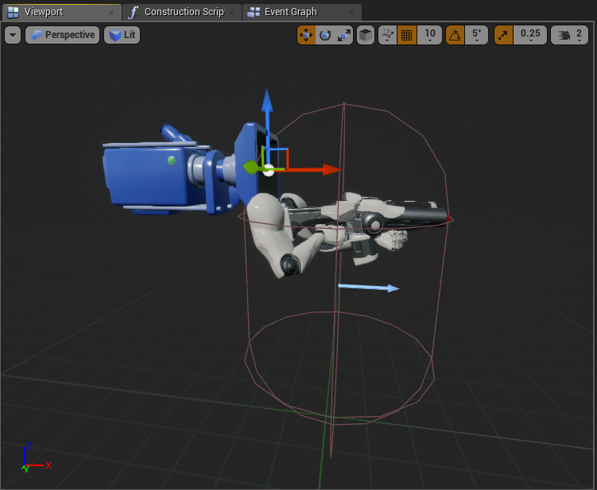
Blueprint editor: Viewport
The Viewport contains the visual representation of the components that are part of the Blueprint.
The components can be manipulated in the Viewport using the transformation widgets in the same way as in the Level Editor.

Slide 17
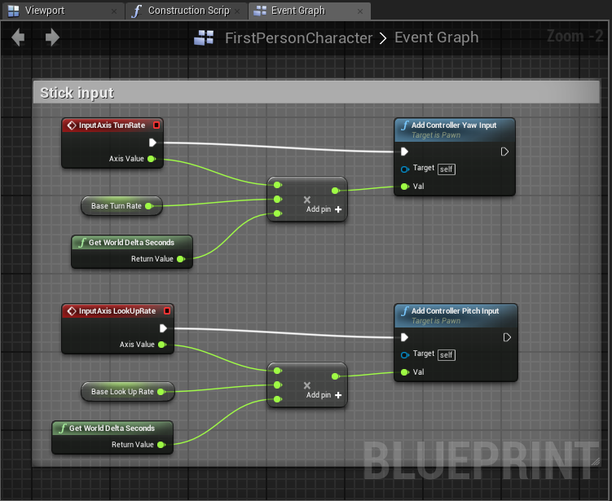
Blueprint editor: Event Graph
The Event Graph is where the gameplay logic that determines a Blueprint class’s behavior during gameplay appears.
The Event Graph contains events and actions represented by a node graph.

Slide 18
PLacing nodes

Slide 19
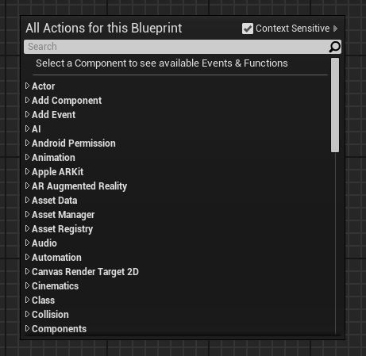
Placing nodes: Context Menu
The context menu is used to add nodes to the graph. The nodes represent variables, operators, functions, and events.
To open the context menu, right-click in an empty area of the Event Graph or drag a wire from a pin of a node and release the mouse button.

Slide 20
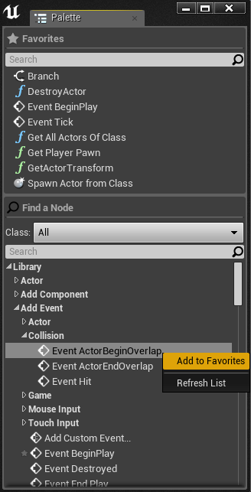
Placing nodes: Palette Panel
There is a Palette panel that can be opened by going to Window > Palette in the Blueprint Editor.
The Palette panel contains a list of all nodes that can be used in Blueprints.
At the top of the panel there is a Favorites section that shows the favorite and most frequently used nodes. To set a node as a favorite, right-click on it in the Palette panel and choose “Add to Favorites”.

Slide 21
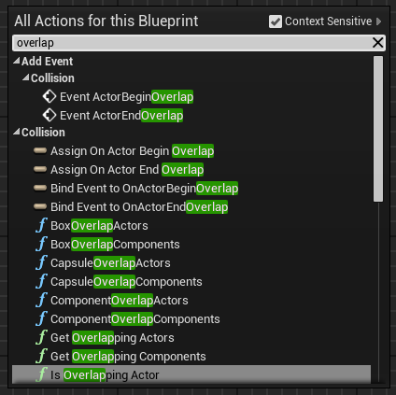
Placing nodes: Search bars
The context menu has a search bar that filters the nodes list when the user is typing.
The Palette panel has two search bars, one for the Favorites section and one for the Palette list.

Slide 22
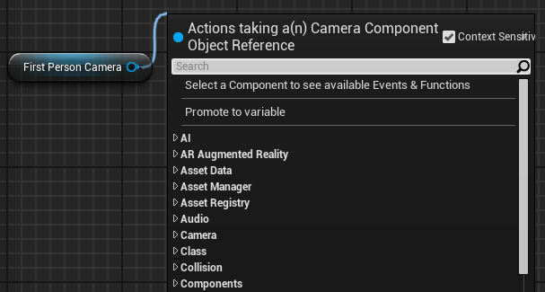
Placing nodes: Context Sensitive
At the top of the context menu, there is a check box named “Context Sensitive”. If it is checked, the list of nodes will be filtered to actions that can be used in the current context.
If the context menu was opened by right-clicking in the Event Graph, the context will be the current Blueprint class. If it was opened by dragging a wire from a pin of a node, the context will be the pin type.

Slide 23
Nodes, pins, and wires

Slide 24
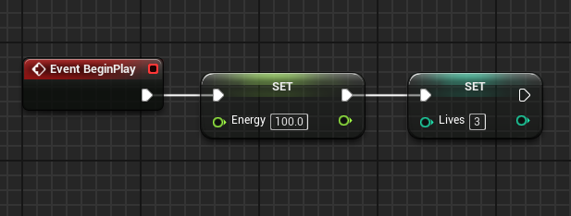
Blueprint graph execution
The execution of the nodes of a Blueprint starts with a red Event node and follows the white wire from left to right until it reaches the last node. After that, it moves on to another Blueprint event that has been triggered.
The white pins of nodes are called execution pins. The other colored pins are the data pins.
In the image on the right, values are assigned to the Energy and Lives variables when the BeginPlay event is triggered.

Slide 25
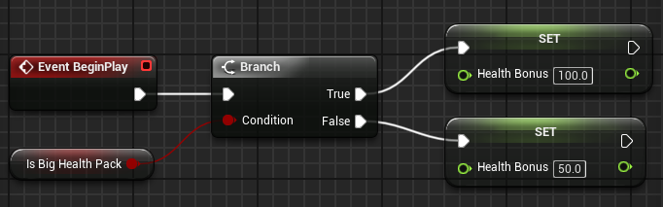
Execution Paths
There are some nodes that control the flow of execution of the Blueprint. These nodes determine the execution path based on conditions.
For example, the image on the right shows a Branch node that is using as a condition the value of the Boolean variable Is Big Health Pack. If the value is “true”, then the execution will continue on the True pin. If the value is “false”, the execution will continue on the False pin.

Slide 26
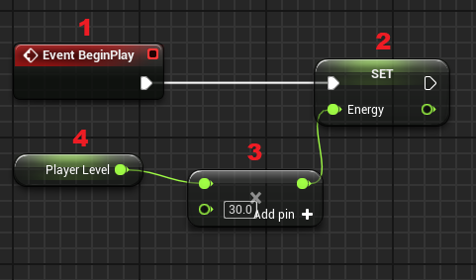
Data wires
When a node with data pins runs, it fetches the required data using the data wires before completing its execution.
In the image on the right, the execution starts with the BeginPlay event. The Set node assigns a new value to the Energy variable, but this value must be obtained using the data wire that is connected to a multiplication node that will need to get the value of the Player Level variable using another data wire.

Slide 27
SUMMARY
This lecture introduced the basic concepts involved in a Blueprint. It explained the difference between Level Blueprints and Blueprint classes and the concept of parent-child inheritance.
It showed the various parts of the Blueprint Editor and explained the flow of execution in a Blueprint graph.

